Slide 1
Fantasy Forecasts
Advanced Modeling

Slide 2

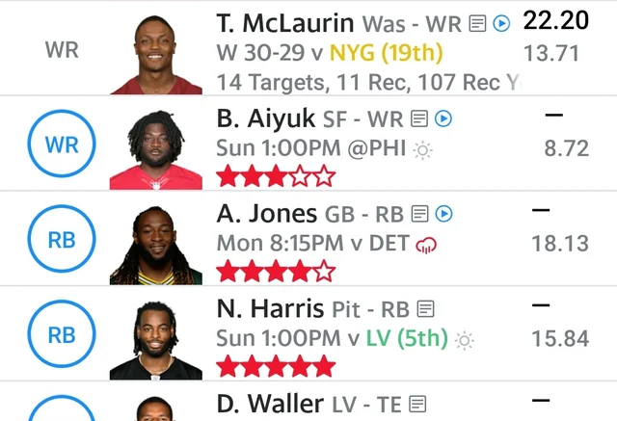
Non-Technical Overview
Problem Statement
By developing predictive models for fantasy points, I can help provide users with data-driven insights that help them make better choices
Fantasy sports players and bettors often struggle to predict player performance accurately, leading to missed opportunities and poor decision-making
Goal
These models aim to improve player performance forecasts, enabling users to make more informed lineup and betting decisions, thus enhancing their overall experience and competitiveness

Slide 3
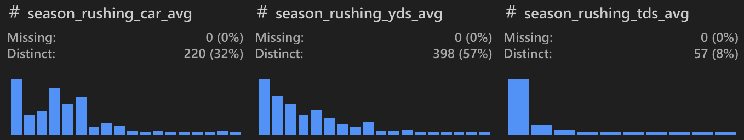
Dataset and Preprocessing Overview
Data
Collected player data for each week of the 2023 NFL season
Divided the data into 4 dataframes, one for each position
Contains various features related to player performance, such as passing/rushing yards, touchdowns, etc.
Preprocessing
Sorted data by PLAYER NAME and DATE for consistent calculations
Removed/created new features to enhance the predictive power of the model
Calculated 5-game rolling averages for key stats to capture recent trends
Computed cumulative season metrics (e.g., season_fantasy_points_avg) for long-term trends
Handled missing values and ensured positional relevance by filtering irrelevant stats

Slide 4
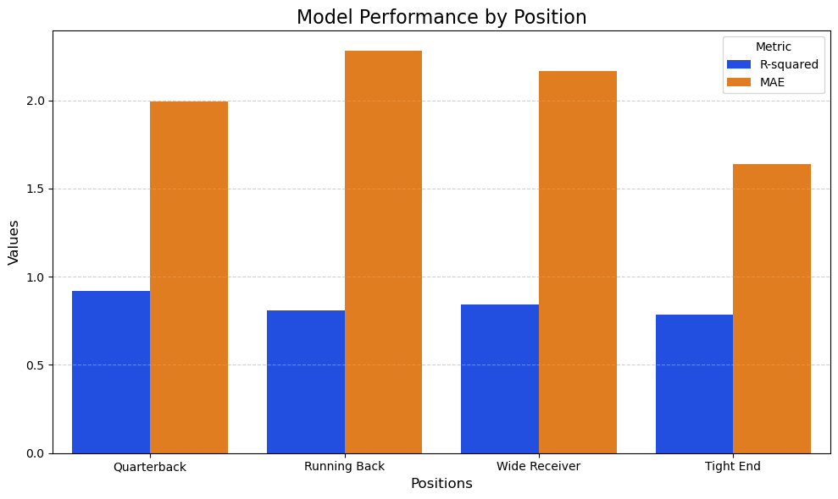
Baseline Models and Evaluation Metrics
Ridge Regression
Introduced regularization to address multicollinearity from overlapping metrics (e.g., season vs. rolling averages)
Performance:
Models performed well
Average R² of ~.83
Average MAE ~2
Models performed much better in regards to MAE when using Grid Search CV
Found that certain positions received better metrics likely due to differences in statistical contributions and variability in performance

Slide 5
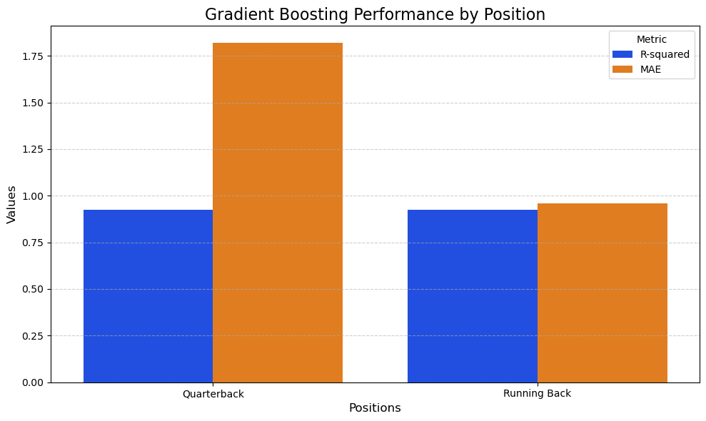
Advanced Models and Evaluation Metrics
Gradient Boosting
Gradient Boosting builds on the baseline by addressing limitations of linearity, capturing feature interactions, and delivering higher accuracy for complex datasets like this one
Performance:
Models performed well
Average R² of ~0.925
Average MAE ~1.38
Grid Search Cross Validation helped decrease average error and mitigate overfitting
So far, the first two gradient boosting regression models have performed much better in regards to R² and MAE in comparison to the ridge regression models

Slide 6
Explanation of Model Performance by Position
Quarterback (QB)
High R-squared, Moderate MAE: Consistent metrics (e.g., passing yards, TDs) make QBs easier to predict with fewer errors
Running Back (RB)
Moderate R-squared, High MAE: Variability in workload (injuries, game scripts) reduces predictability and increases error
Wide Receiver (WR)
Moderate R-squared, High MAE: Dependent on QBs and game plans, with boom-or-bust performance patterns causing variability
Tight End (TE)
Low R-squared, Lower MAE: Limited opportunities and inconsistent usage make TEs the hardest to predict
Key Insight: Predictability aligns with position stability and volume of opportunities

Slide 7

Next Steps
Finish Advanced Modeling:
Complete Wide Receiver and Tight End Gradient Boosting Regressor Models
Metrics Analysis:
Complete full analysis of baseline and advanced modeling metrics
Productization:
Develop a user-friendly application for fantasy managers to access predictions

